Slide 1
Dynamic Alignment to Consumer Sentiments using Online Platforms
Nishant Das
13th May 2019

Slide 2
Monitoring Online Review Scores to align to Consumer Requirements
Consumer satisfaction is a strong ingredient to commercial success in B2C markets.
This is true for both product and service sector industries.
Methods of determining consumer reaction and perception to innovation and change (both internal & external) were dependent on traditional market research methods such as consumer surveys, focus groups, etc.
Due to increase in online chatter, online communities where consumers review a product (or service) offers another opportunity to monitor consumer reaction.
Further, consumer data from online environments is of high frequency, i.e. it is much more dynamic and quick.
The question is, are signals from such online platforms reliable?

Slide 3

Online Gaming Community

Slide 4
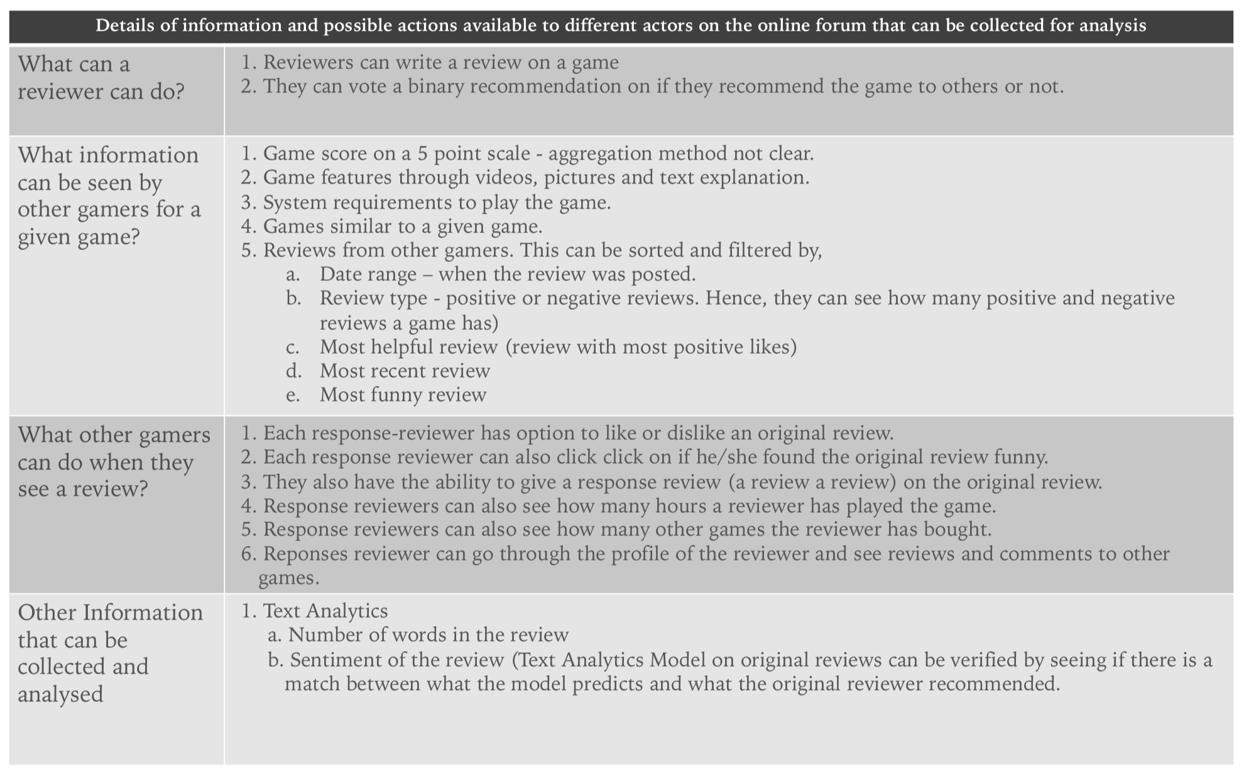
Overall Data Attributes

Slide 5
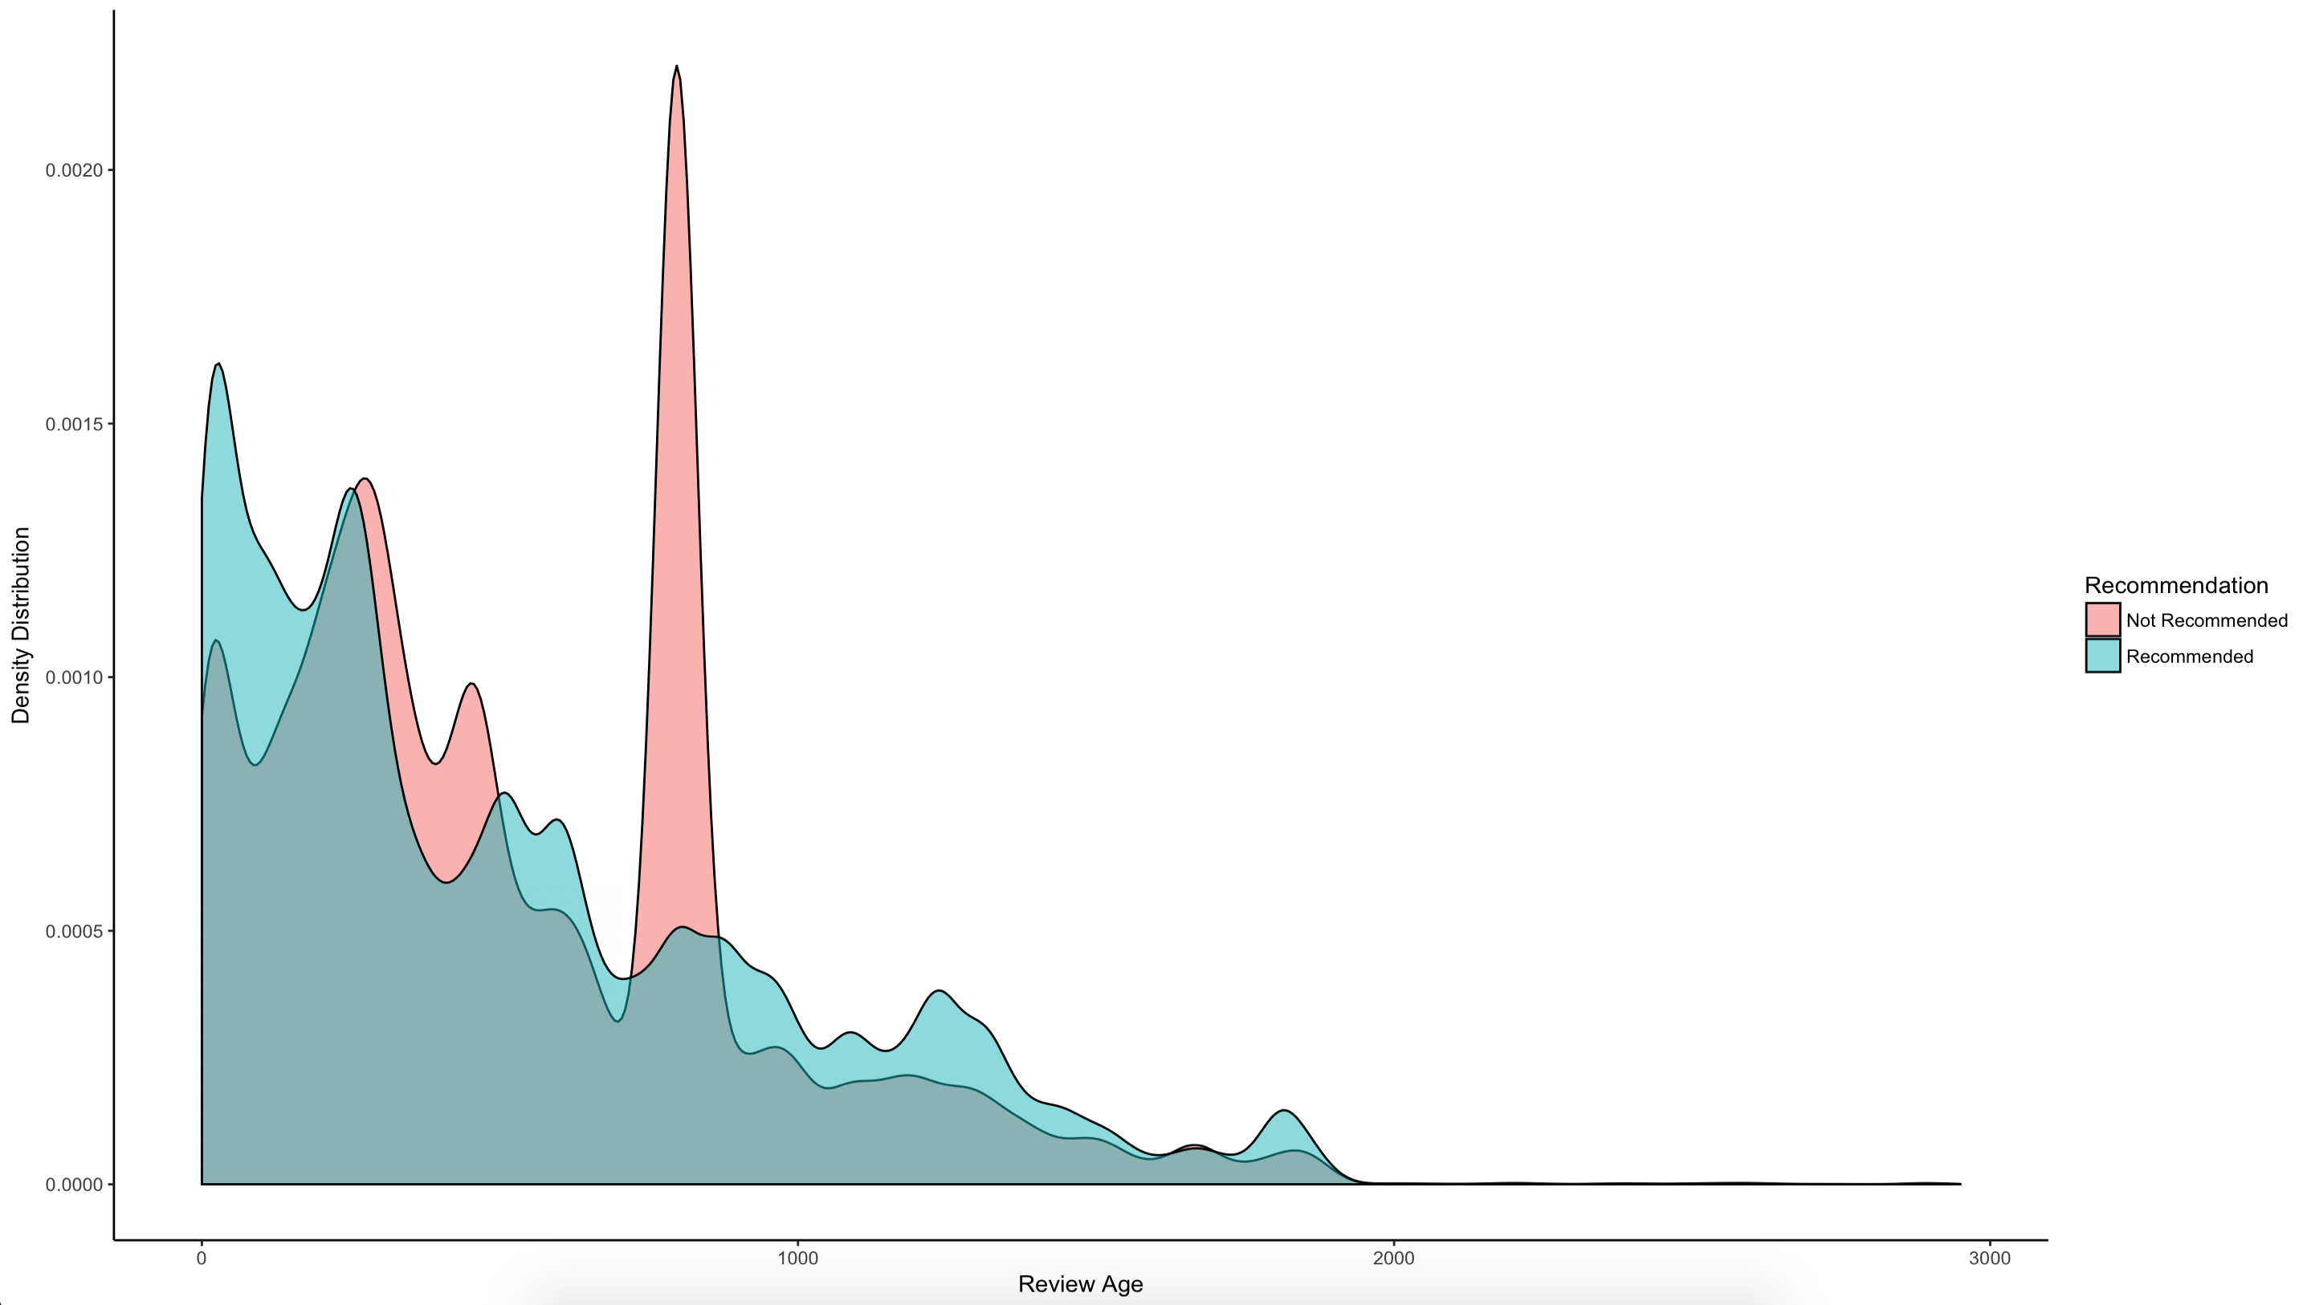
Upon investigating the data I noticed a strong spike in negative reviews in a certain time interval.

Slide 6
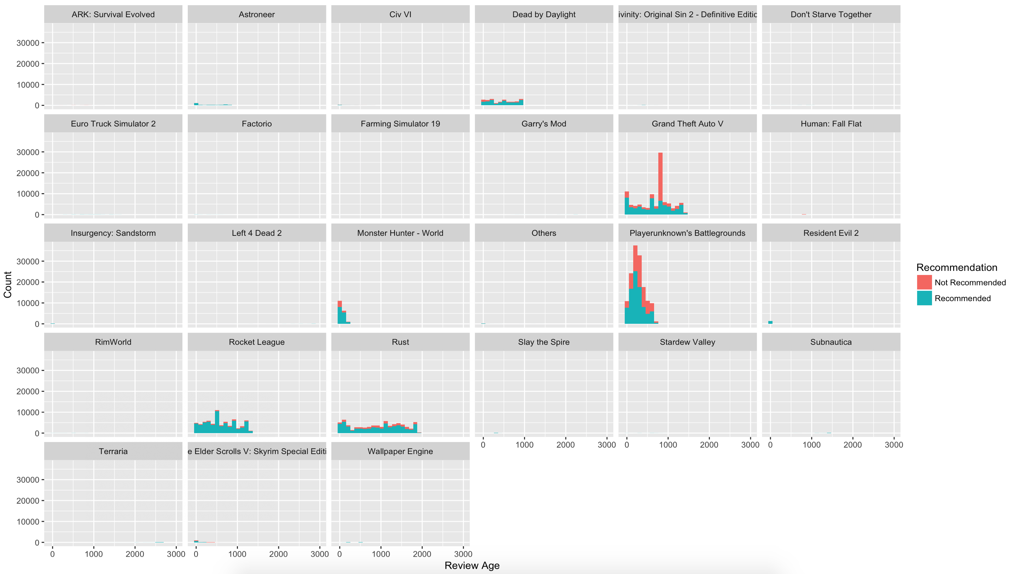

Slide 7
The reason for the spike in negative reviews
Grand Theft Auto V
Mods = Gamer allowed to modify their characters, gaming experience, etc.
The game’s parent company, Take-Two Interactive, had cancelled modification ability of gamers.
This resulted in large number of games responding negatively to the game.
Around 80,000 people supported a change.org campaign.
Public response was so strong, that the company had to reverse it’s policy in 3 weeks.

Slide 8



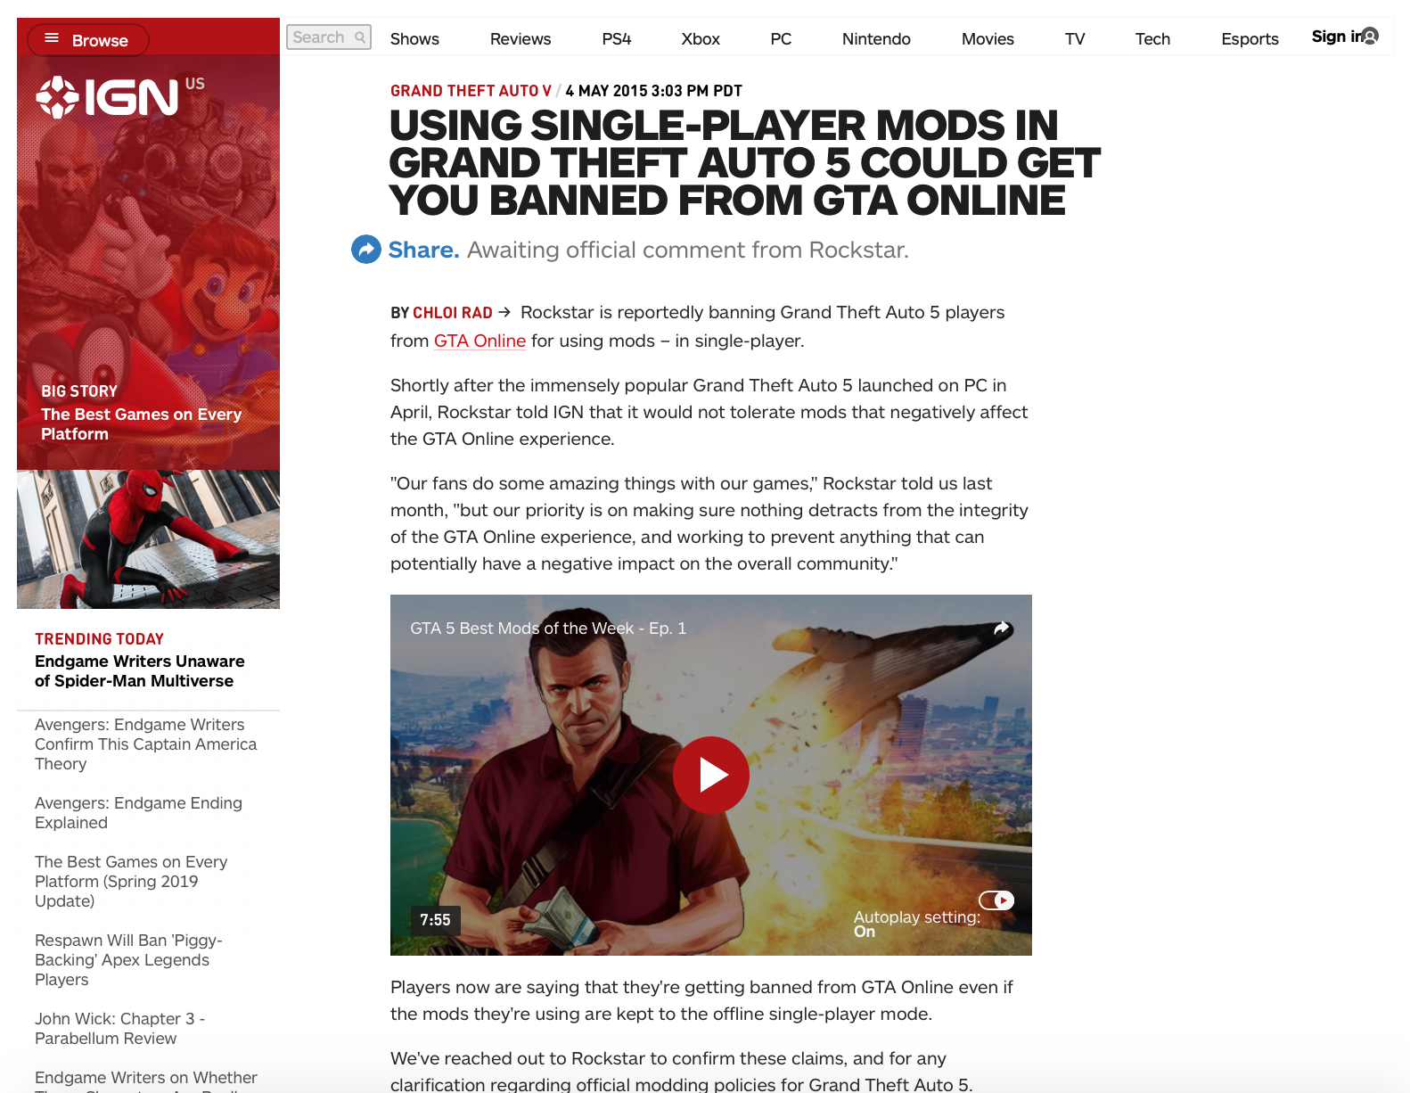


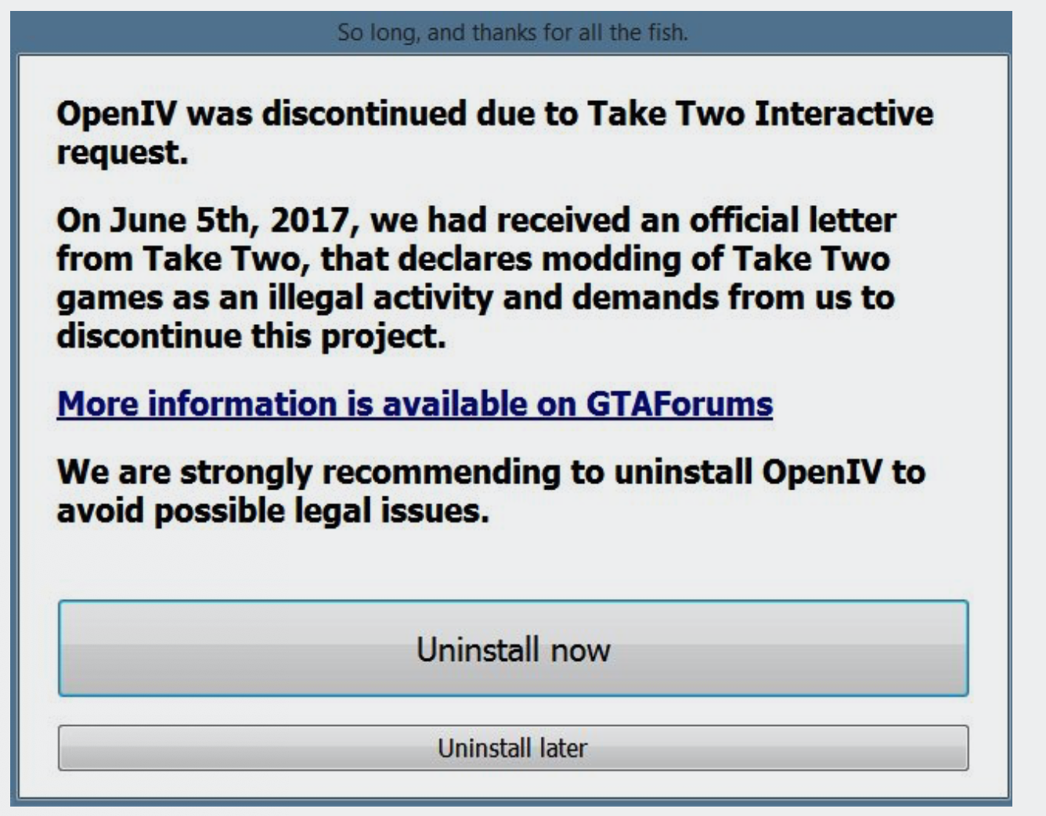

Slide 9
Clearly, there was a strong change in consumer sentiments. Good opportunity to check if shift in public sentiment was registered in online forums too.
Can product review mechanism in online forums capture shift in public sentiment?

Slide 10
Hypothesis
Consumer ratings in online forums can detect change in consumer sentiments.

Slide 11
Study Specific Data Attributes
The Game Title
Time the reviewer posted the review.
If the reviewer recommended the game or not.
The control variables such as comment and game characteristics.

Slide 12
Summary Statistics
Reviews from December 2010 to February 2019
433321 reviews in total
48 titles in total
Collapsed titles with less than 10 reviews as “Others” for the data summary and statistics and graphs. For models, not.

Slide 13
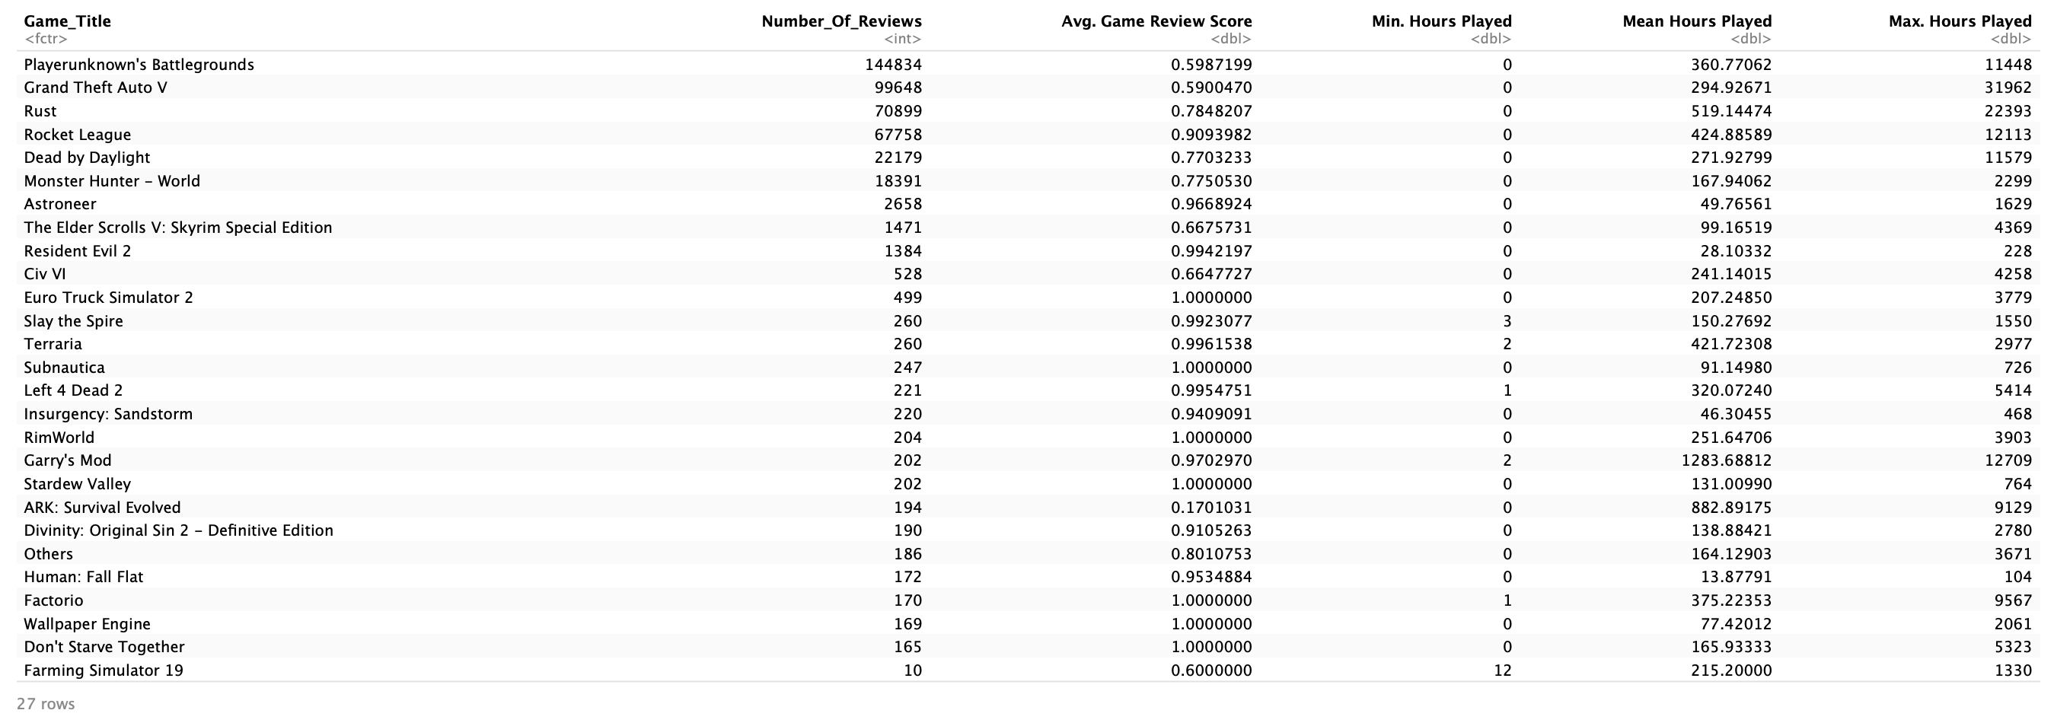
Some Game & Consumer Statistics

Slide 14
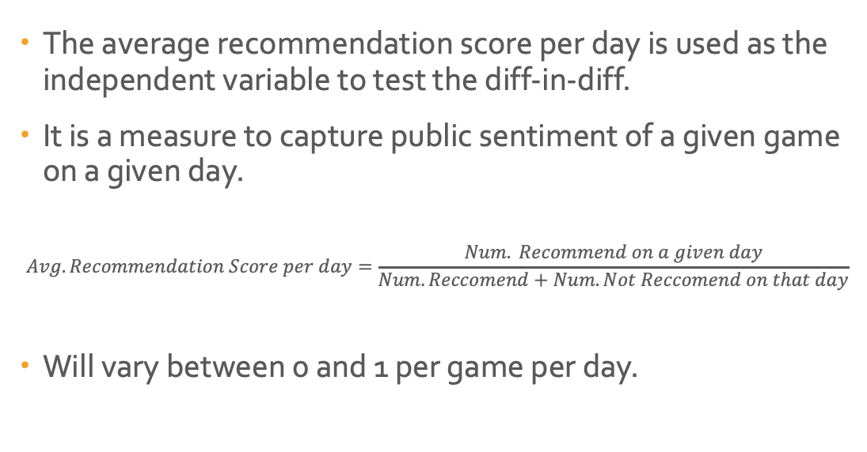
Average Recommendation Score per day
The average recommendation score per day is used as the independent variable to test the diff-in-diff.
It is a measure to capture public sentiment of a given game on a given day.
$$Avg. Recommendation Score per day=\frac{Num. Recommend on a given day}{Num. Reccomend+Num. Not Reccomend on that day}$$
Will vary between 0 and 1 per game per day.

Slide 15
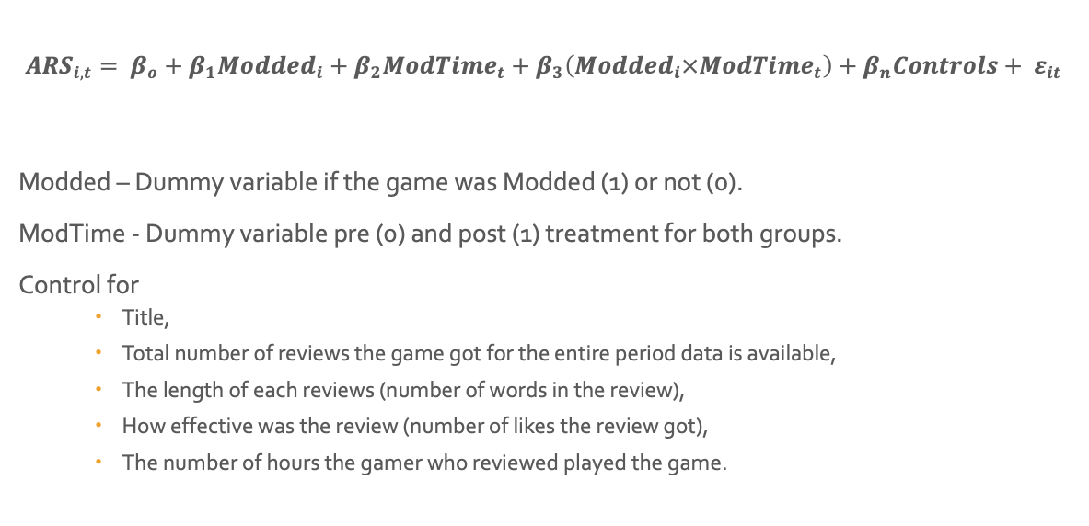
Diff-in-Diff Model
$${ARS}_{i, t}= β_{o}+β_{1}{Modded}_{i}+β_{2}{ModTime}_{t}+β_{3}\left({Modded}_{i}×{ModTime}_{t}\right)+β_{n}Controls+ ε_{it}$$
Modded – Dummy variable if the game was Modded (1) or not (0).
ModTime - Dummy variable pre (0) and post (1) treatment for both groups.
Control for
Title,
Total number of reviews the game got for the entire period data is available,
The length of each reviews (number of words in the review),
How effective was the review (number of likes the review got),
The number of hours the gamer who reviewed played the game.

Slide 16
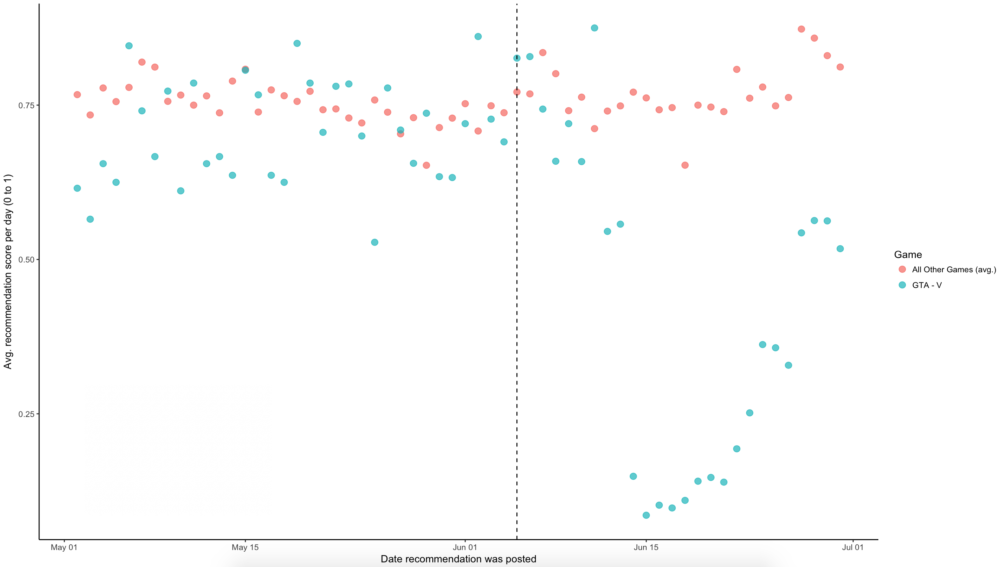
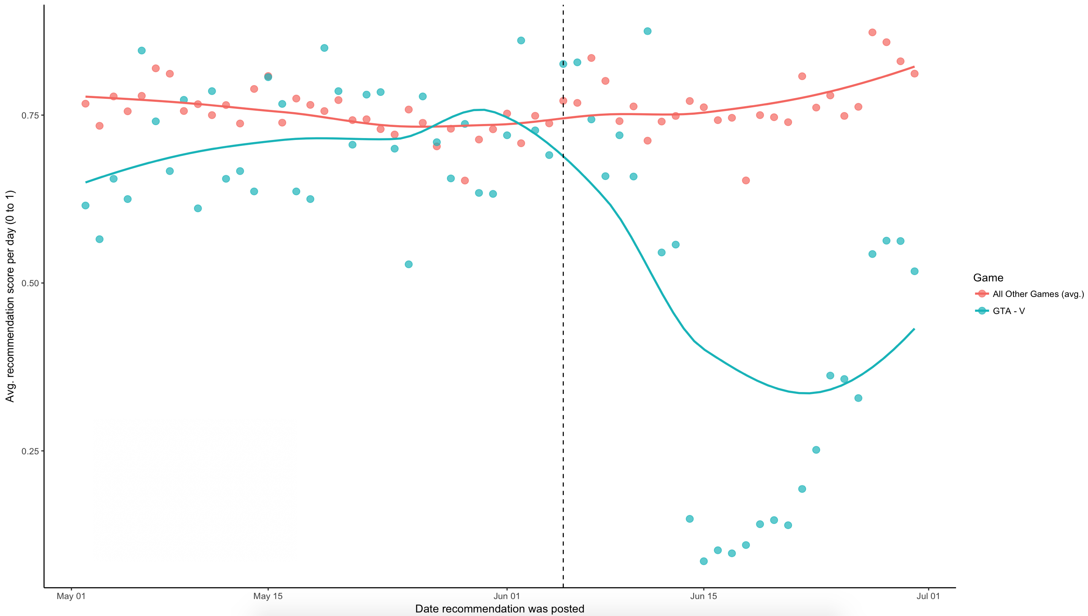
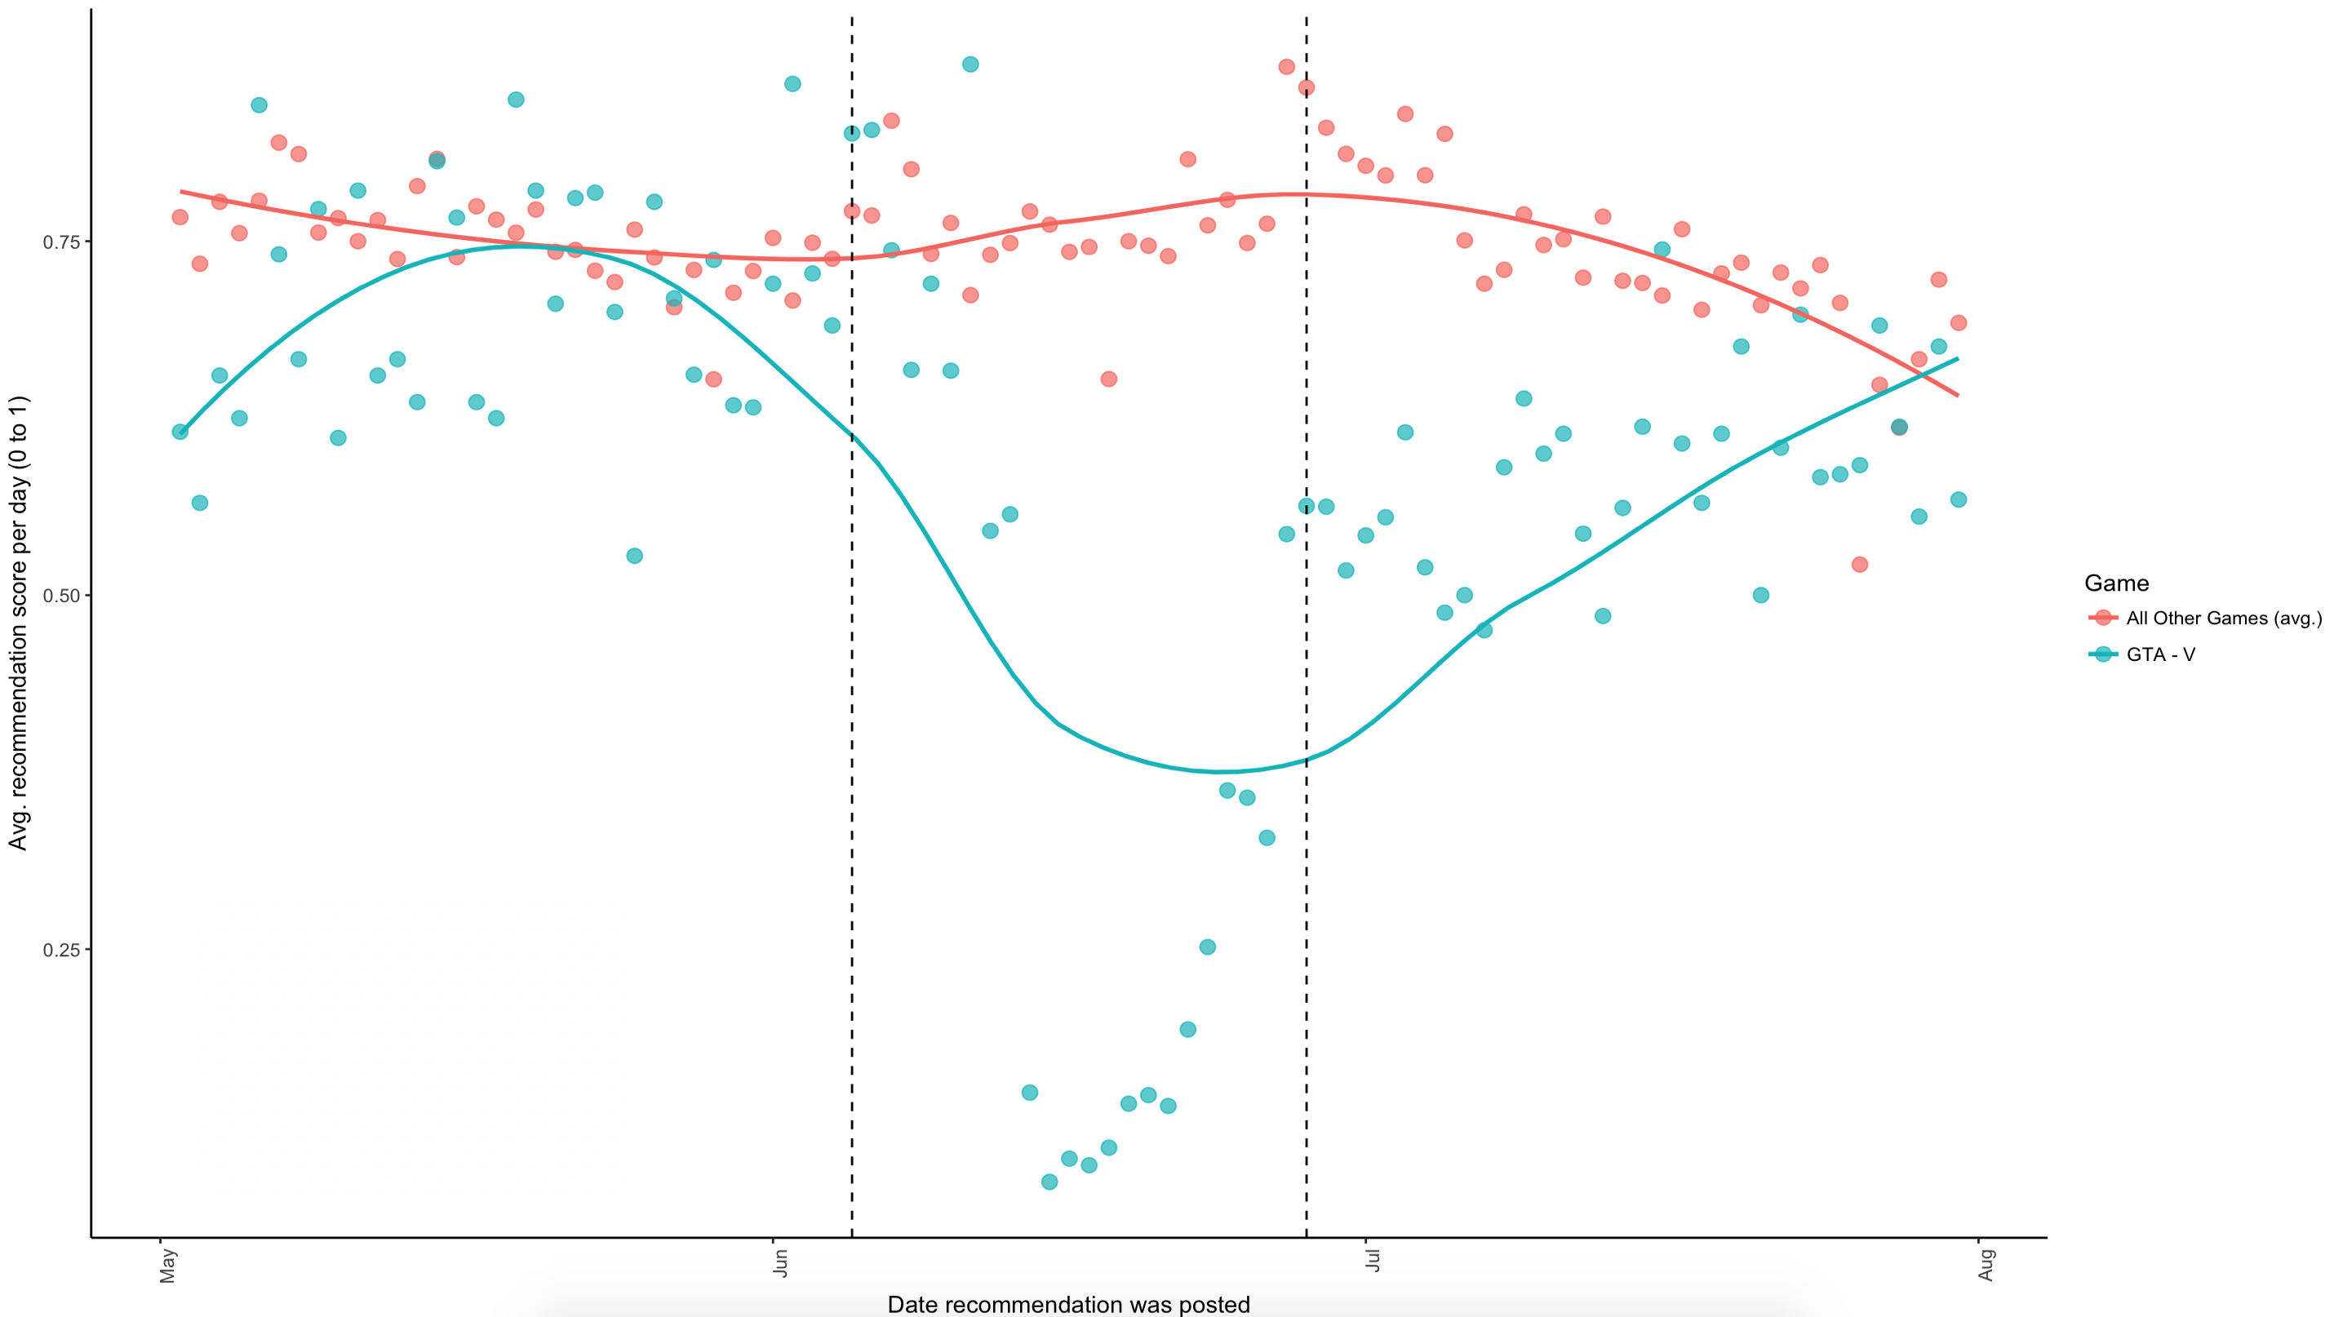
Diff-in-Diff Model Treatment Control = 328710 Treated = 76166 Treatment Time 5th June 2017 to 25th June 2017
Disabled Modding
Enabled Modding

Slide 17
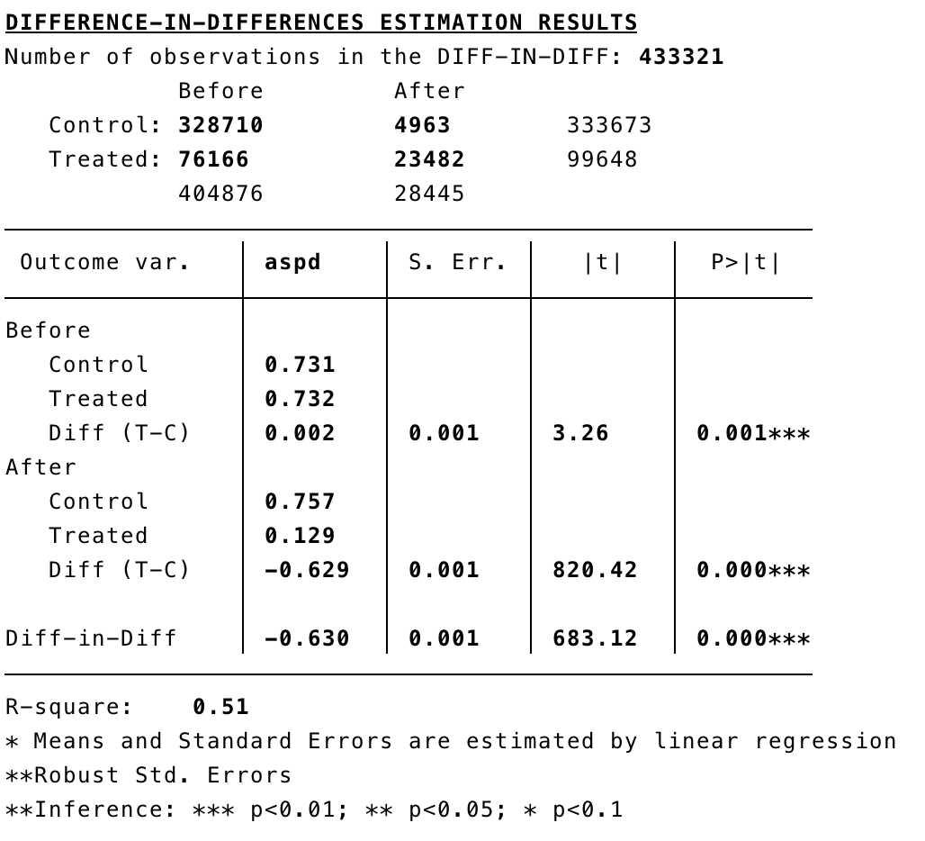
Diff in Diff Model Results Is the difference in Before & After the difference

Slide 18
Results
 | (1) | (2) | (3)
VARIABLES | Model 1 | Model 2 | Model 3
modded | -0.00667 | -0.0154 | -0.0853***
 | (0.0104) | (0.00936) | (0.0130)
modtime | 0.0447 | 0.0451 | 0.0449***
 | (0.0359) | (0.0359) | (0.00105)
did | -0.648*** | -0.649*** | -0.649***
 | (0.0359) | (0.0359) | (0.00128)
nHelpful |  | -1.24e-06 | -3.33e-06
 |  | (5.01e-06) | (4.87e-06)
nFunny |  | -3.95e-06 | -5.13e-06
 |  | (8.16e-06) | (6.87e-06)
hours_played |  | -3.01e-06 | -3.30e-06***
 |  | (2.06e-06) | (3.56e-07)
Review_Num_Words |  | -6.77e-05***
 |  | (1.09e-05)
Constant | 0.739*** | 0.751*** | 0.819***
 | (0.0104) | (0.00941) | (0.0130)
Observations | 433,321 | 433,321 | 433,321
R-squared |  |  | 0.591
Number of title_coded | 48 | 48
DID estimator is very significant in all models.
Estimator value is -0.648 on average.
This implies that there was a fall of 0.648 points (on a 0 to 1 scale) in average game recommendation due to removing modding abilities of Gamers playing GTA – V.
Hence, while previously the average game score was 0.731, after the treatment the average game score fell to 0.129.

Slide 19
Conclusion & Discussion
We can conclude that company polices that effect consumer sentiments have a significant impact on voter ratings and recommendations in online forums.
In this sense, companies should closely monitor online forums and platforms in real-time (dynamic) using high frequency user reviews and ratings in order to get a sense of changing consumer sentiments to internal & external innovations, changing company policies, etc.

Slide 20
Any Questions, Comments or Endogeneity Concerns?
Thank You!

